Slide 1
Learning Cell Communication From Spatial Graphs of Cells
David S. Fischer, Anna C. Schaar, Fabian J. Theis
Amit Damri
Data Science in Cell Imaging

Slide 2
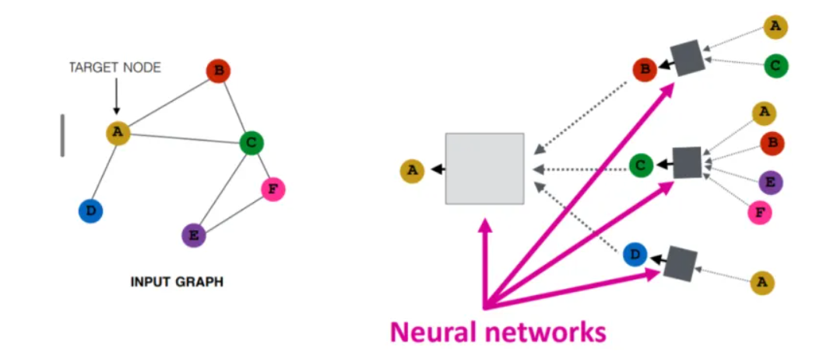
Graph Neural Network

Slide 3
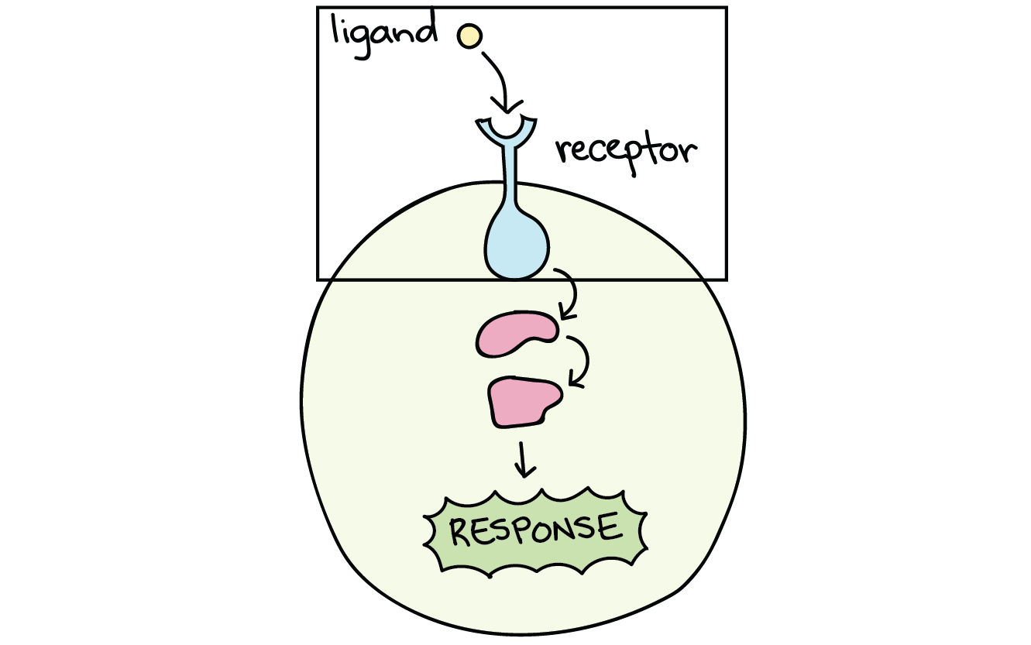
Current Methods & Limitations
2 main assumptions
Co-occurrence
Gene expression

Slide 4
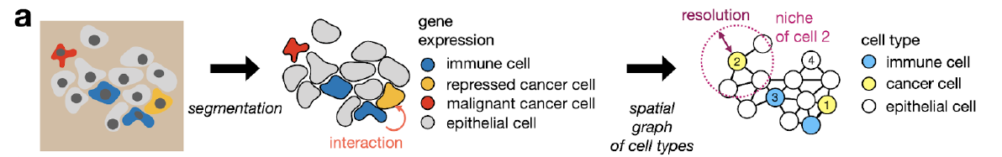
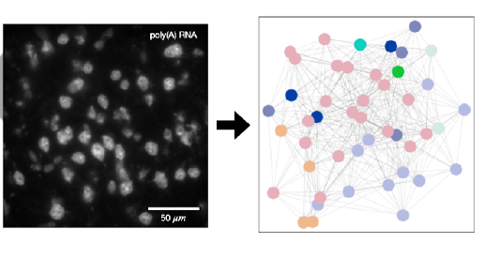
Node-Centric Expression Model (NCEM)

Slide 5
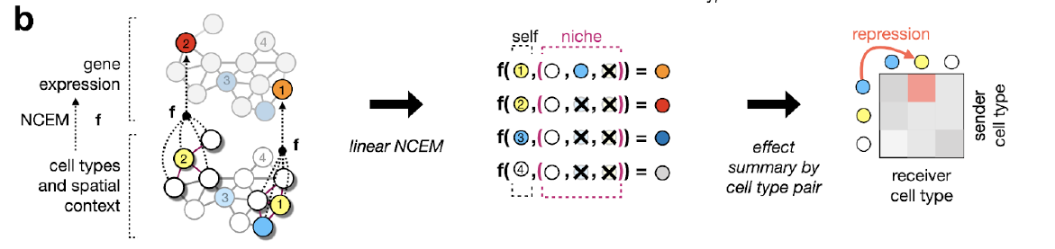
Linear NCEM
Notes:
the indicator function aggregator summarizes a set of one-hot encoded cell-types in a niche to a vector with binary elements that indicate the presence of each cell-type in the niche.

Slide 6
Datasets
Image-structured data from molecular profiling assays
5 datasets
MERFISH, MIBI-TOF, chip cytometry, etc.

Slide 7
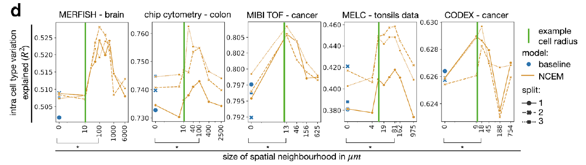
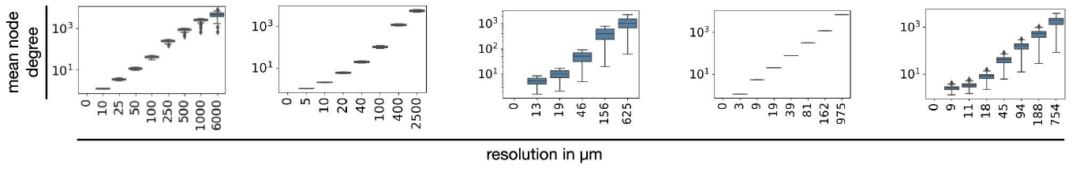
Linear NCEM - Results
Notes:
with further increasing neighborhood sizes, the prediction performance drops again to the level of nonspatial models, indicating that the spatial effect is not simply due to overfitting to images.
The NCEMs outperformed non-spatial baseline models

Slide 8
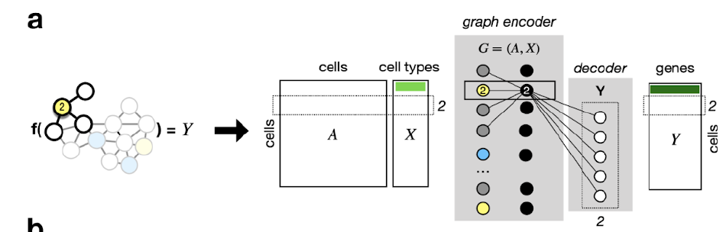
Nonlinear NCEM
Higher order interactions

Slide 9
Critic & Personal Opinion
Spatial spillover
Technological limitations
Bottom line: Very cool idea and great GitHub tutorial!

Slide 10

Thank you, Questions?

Slide 11
References
1. https://www.molecular-machines.com/solutions/spatial-transcriptomics
2. https://www.biorxiv.org/content/10.1101/2021.07.11.451750v1.full.pdf
3. https://www.khanacademy.org/science/ap-biology/cell-communication-and-cell-cycle/signal-transduction/a/signal-perception

